Slide 1
Objectives
By the end of this lesson you will be able to:
Use and understand the various file formats and images

Slide 2

File Formats
What are file formats/ extensions?
A file format/ extension relates to the last three/ four letters at the end of a file name e.g. image_transfer.doc
It is possible that you cannot see them as your computer may be set to hide them

Slide 3
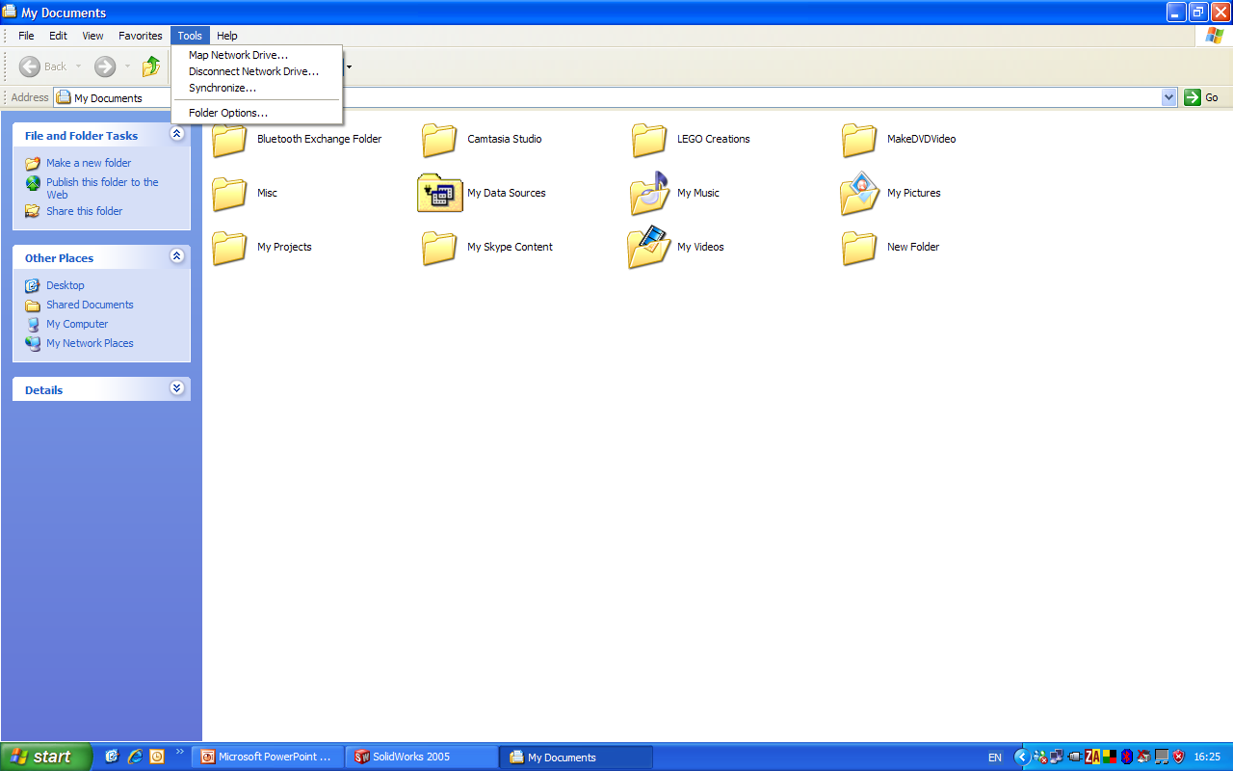
File Formats
To show the file extensions you need to:
Select the “Tools” menu in a folder
Select “Folder Options”
A new dialog box will appear
Click on the “View” tab along the top of the dialog box
Scroll down the list of options and uncheck the box beside “Hide extensions for known file types”

Slide 4
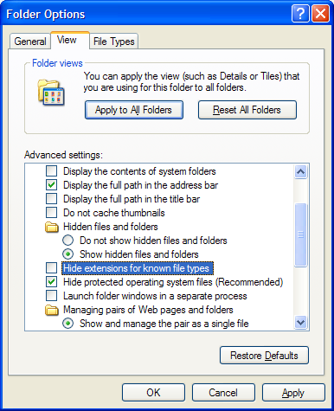
File Formats

Slide 5
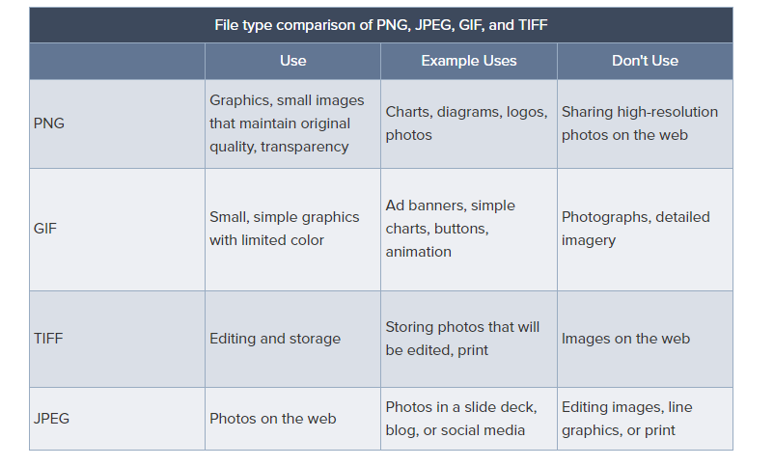
File Formats

Slide 6

File Formats
What it the purpose of file formats/ extensions?
File formats/ extensions are there so that your computer knows what programme to use to open the file
As you may already know it is not possible to open a music file (.wma) in Microsoft Word (.doc) and so on

Slide 7
File Formats
Why would you use different file formats?
The reason for using a different file format when saving a document is that each format will have different properties that may be required for your document
This is particularly important when saving graphics e.g. The GIF format is used for still images and simple animations and a JPEG will only store static photographic images

Slide 8
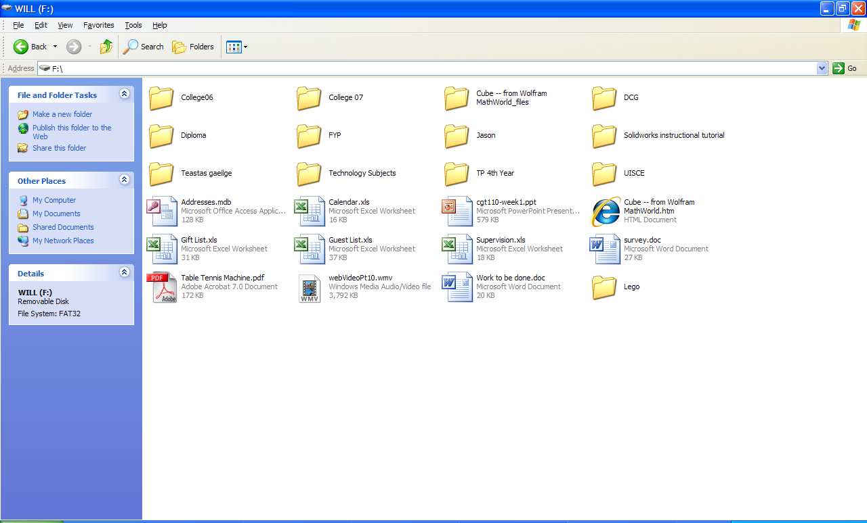
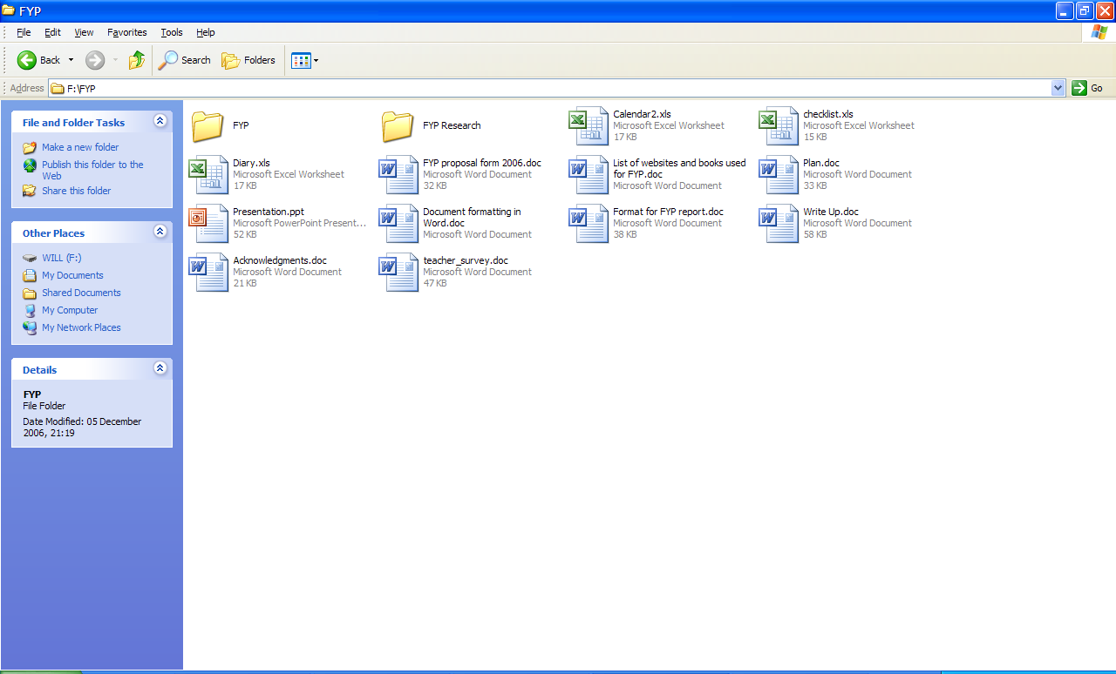
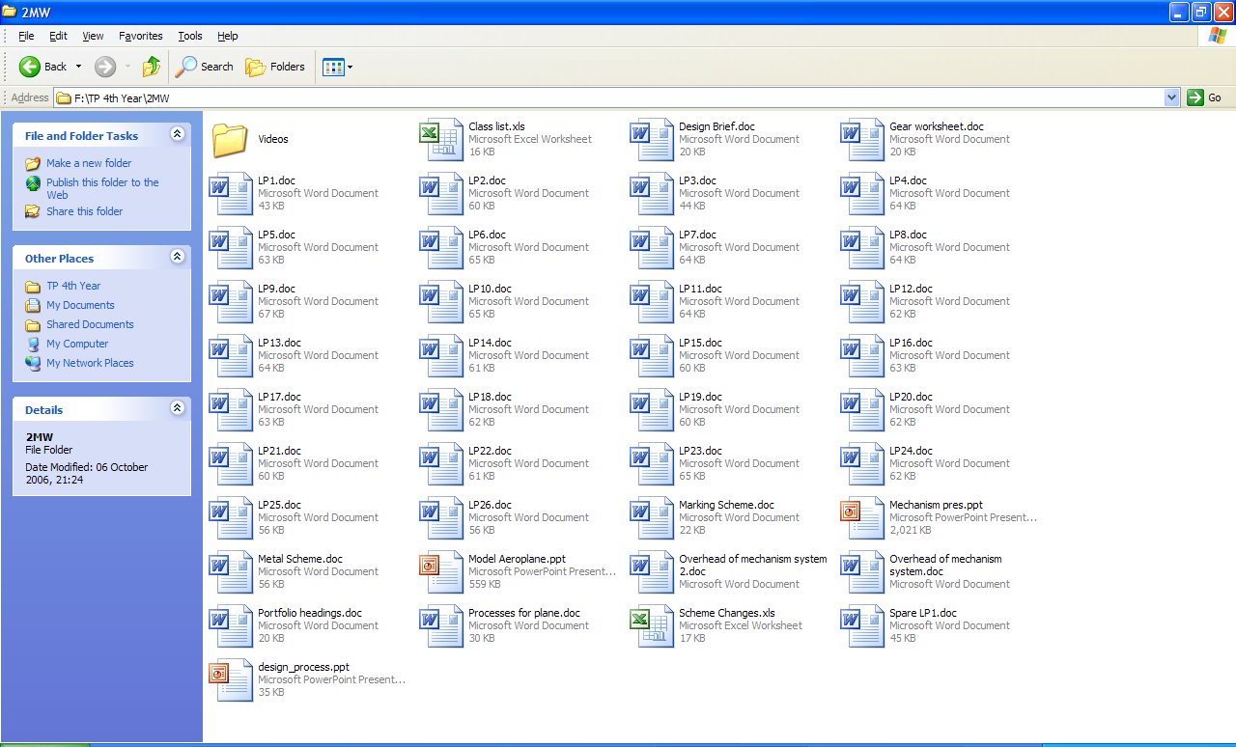
File Formats
These are some of the file formats/
extensions that are related with the ICT
applications on your computer:
.doc – Microsoft Word
.xls – Microsoft Excel
.ppt – Microsoft PowerPoint

Slide 9
Image file formats
Below are some of the file formats/ extensions that are related with image files on your computer:
.JPEG - Joint Photographic Experts Group
.GIF - Graphics Interchange Format
.TIFF – Tag Image File
.PNG – Portable Network Graphics

Slide 10
What is a PNG file?
A PNG, or portable network graphic, is a raster file that supports lossless compression. Its transparent background allows it to be embedded into other images or graphics without additional editing steps. This higher-resolution format delivers higher-quality images and clearer text, but the larger file size can slow down website performance and document load times.

Slide 11
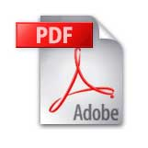

PDF Format
What is a PDF?
PDF stands for “Portable Document Format”
It is used for creating electronic documents
The file extension is .pdf

Slide 12
PDF Format
Advantages of PDF
PDF files are compact. It helps to minimise the size of a file and keep it at a minimum
Once a file is created using PDF it cannot be edited by any third parties
PDF can contain multimedia elements like movies and sound as well as links to webpage's

Slide 13

PDF Format
How to create a PDF?
To do this you will need to have specific software that will create a PDF for you on your computer such as CutePDF Writer which can be downloaded free from the internet
http://www.cutepdf.com/Products/CutePDF/writer.asp

Slide 14
References
Text Books:
Reference Links:
https://www.widen.com/blog/whats-the-difference-between-png-jpeg-gif-and-tiff
https://www.brainkart.com/article/File-Formats-for-multimedia_37404/
Video Reference Links:
https://www.youtube.com/watch?v=dYWyFiI2RT4
https://www.youtube.com/watch?v=le2xh4XQkIM

Slide 15

Thank you

